Slide 1
IAT Comparing Cats vs. Dogs
By: Katie Whisnant

Slide 2
This Study
Performed an Implicit Association Test designed to compare cats and dogs against positive and negative words
Possible moderators:
Allergies to cats and/or dogs
Cats/dogs as pets at home
Anticipated Findings:
People associated cats with more negative words
People with cat allergies would be more likely to think of cats negatively
People who had cats were more likely to think of cats positively
No relationship between the two tests both in general and with any moderators

Slide 3
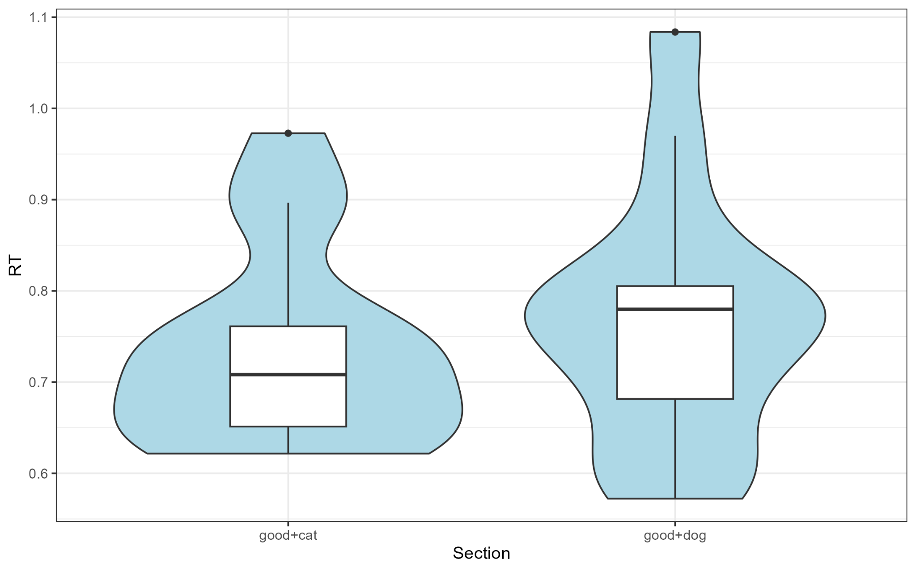
Comparing the Two Groups
Notes:
To present the data, I chose to do a violin plot and overlay a box plot on top of it. As you can see, these graphs actually show the opposite of what my predictions were. The reaction times when pairing good with dogs is actually higher than when pairing good with cats, meaning people had to think longer to sort it into the correct categories. This was quite surprising for me because I expected to see the opposite. Also, the box plots show that the median reaction time and the range of reaction times was lower for the cat pairing than the dog pairing. However, the dog pairing had a much longer range than the cat pairing, so maybe with a larger sample size there would be different results. However, for this sample, as these graphs show, there are no significant result because the groups are relatively similar.

Slide 4
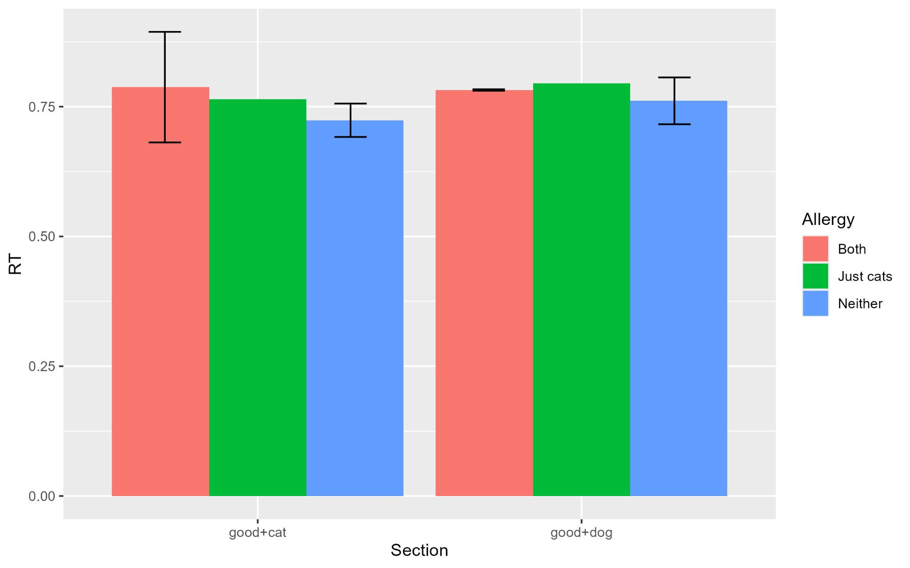
Looking at Allergy Moderator
Notes:
As you can see, there is really no difference in the two sections when looking at Allergies as a moderator. People who have allergies to both cats and dogs and just cats had a higher reaction time in general to people who had neither allergy. However, this difference is super tiny.

Slide 5
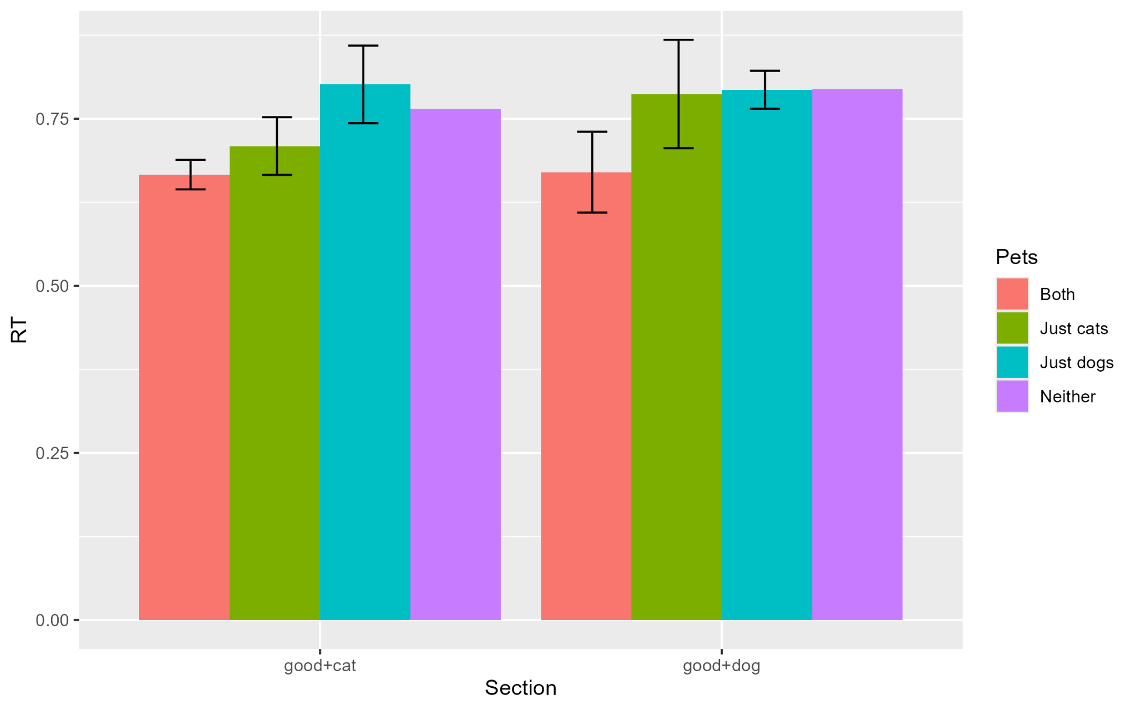
Looking at Pet Moderator
Notes:
Again, there is really no difference in the two categories when looking at Pets as a moderator. However, the participants who have both cats and dogs at home tend to have lower reaction times in general than the the people who have only cats, only dogs, or neither cats nor dogs as pets. This could be interesting, for with a larger sample size there could be more obvious differences between the groups. They’re a little less similar than the Allergy moderator, so maybe this could lead to significant results with a larger participant pool.

Slide 6
Limitations
The sample size was 15
Using a larger sample size, there could be effects that were not significant with such a small group
The moderators had to be adjusted and even disregarded because each group was so small

Slide 7
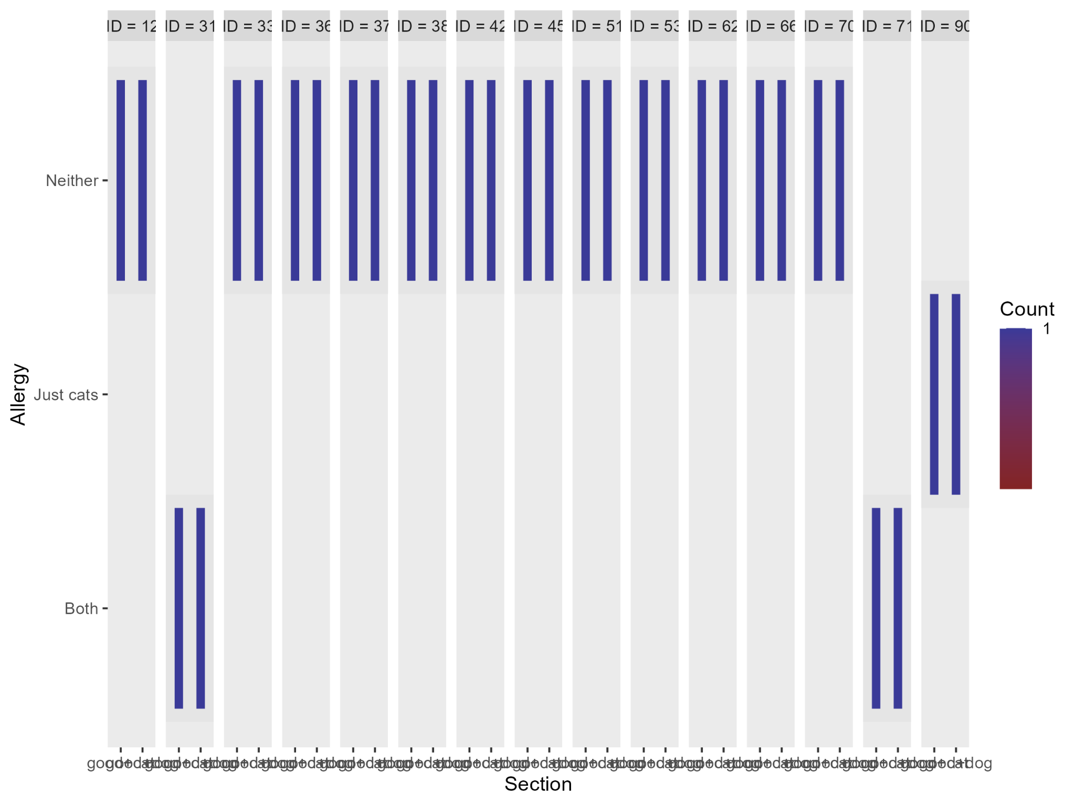
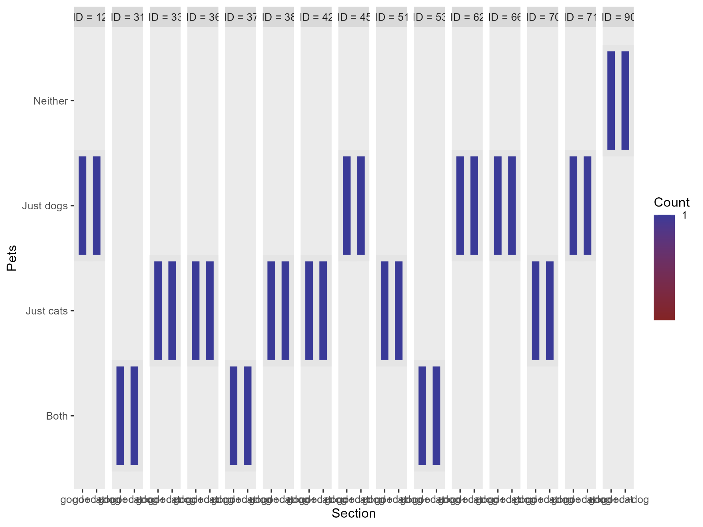
Moderator Counts
Notes:
Here are the counts for the moderators. As you can see, these groups are highly imbalanced. While the Pet moderator was decently balanced except for one participant, the Allergy moderator was highly imbalanced and one answer choice wasn’t even represented. I first tried running ANOVAs with this group, but the data proved to be too imbalanced to produce good results. As Dr. Parikh suggested, I also tried testing the Pet moderator after removing the outlying participant, but there were still no significant results.

Slide 8
Future Directions
Use a larger sample size
Create more equal groups to allow testing for moderators
Change images used
Some images were AI generated
Test out photos and make sure they are neutral and similar so there are no accidental biases
Change words used
Choose positive and negative words that are antonyms to allow for easier grouping
Add at least one more trial of each pairing to gather more data
Could make each pairing appear on both sides of the screen

Slide 9
Any Questions?

